Slide 1

Meta Programming in C++
Unleashing the Power of C++

Slide 2
Agenda
Introduction to metaprogramming and its benefits ✓
Templates and their Role in C++ Metaprogramming✓
Compile-time constant expressions and their usage in generating code✓
Conditional compilation and its role in metaprogramming
Creating compile-time data structures and algorithms
Optimizing code for specific architectures and platforms using metaprogramming
Perform complex computations and optimizations with metaprogramming

Slide 3
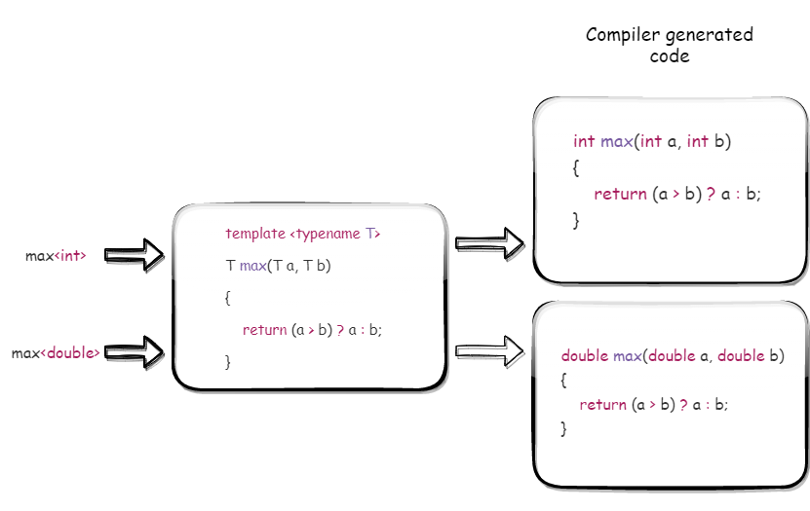
Template : Art of Generic Programming
Generic programming is a technique that allows us to write code that can work with multiple types of data.
In C++, we use templates to achieve generic programming.
Templates enforce the C++ compiler to execute algorithms at compilation time, which gives us more flexibility to write generic program to avoid run-time overhead (Ex 1 and Ex 2)
The keyword template always begins a definition and declaration of a function template and class template. The <> brackets contain a list of template parameters.
The keyword typename (or class) tells the compiler that what follows is the name of a type
Function template and class template with Example.
type parameter vs non-type parameter (Ex 3)

Slide 4
Template Specialization
Template specialization allows us to define specific implementations of a template for particular types.
Explicit specialization (aka Full specialization) - where a unique version of the template is defined for a specific type. (Ex1 and Ex 2)
Partial specialization - where a template is defined that acts on a qualified range of types. (Ex 3)

Slide 5
Advanced Templates
Dependent Names: A Dependent Name is any name within a template definition that depends on one or more of the template parameters (Ex 1)
By checking dependent names at compile time, you can catch errors early in the development process, before they cause problems at runtime (Ex 2)
Template Template Parameter: A template template parameter is a template parameter that accepts a template as its argument. (Ex 3)
instead of passing a type or value as an argument to a template, we can pass another template.
Parameter Packs : Allow a function or class template to accept an arbitrary number of template arguments.
Parameter packs are defined using the ellipsis ‘…’ syntax.
The typename… T_values is called template parameter pack
Variable Templates : Variadic templates in C++ allow you to create functions and classes that can take a variable number of arguments of different types using Parameter pack.
Syntax template<typename... Ts> class ClassName {};
Variadic function template (Ex 4)
Variadic class template (Ex 5)
template<typename... Args> void myFunction(Args... args) { // Do something with each argument... }

Slide 6
Advantages of using Templates
Code reusability: Templates allow us to write generic algorithms or data structures that can work with different types, without having to rewrite the code for each type.
Type safety: Templates ensure that the code is type-safe by performing type checking at compile-time. This helps to catch errors early in the development process, before the code is executed.
Performance: Templates can be used to generate specialized code for each type, which can result in faster code execution compared to using a generic algorithm.
Flexibility: Templates provide flexibility to the programmer to customize the behavior of a function or class for different types, without having to write separate code for each type.
Standardization: Templates are part of the C++ standard library, and many common algorithms and data structures are already implemented as templates. This makes it easy for programmers to use these standard templates in their code and ensures consistency across different projects.
Better code quality: Templates encourage better coding practices, such as separation of concerns, code reuse, and maintainability, which can lead to higher quality and more reliable code.

Slide 7
Meta-Programming using Templates
Intro to Meta-Programming
Meta-programming in C++ is the process of using templates to write programs that generate other programs at compile-time.
Template metaprogramming in C++ is based on the concept of template specialization.
Metaprogramming in C++ can be used to implement complex algorithms at compile-time, such as sorting, searching, and mathematical calculations.
Common applications of metaprogramming in C++ include generating serialization/deserialization code, implementing static assertions, and performing compile-time optimizations.
Metaprogramming can be used to improve the performance of C++ programs, by moving calculations and code generation from runtime to compile-time.

Slide 8
Recursion in Meta-Programming
Recursion in metaprogramming refers to calling a template function or class repeatedly with different parameters during call
It is a fundamental technique used for complex operations such as calculating factorials or traversing data structures at compile-time compile-time.
Recursion is implemented using template specialization, with one or more base cases that stop the recursion.
Excessive use of recursion can make code difficult to understand and maintain, and may introduce errors.
Ex 1

Slide 9
Type Traits in Meta-Programming
Type traits are templates that provide information about types at compile-time.
They can be used to check type properties such as whether a type is a pointer, whether it has a specific member function, or whether it is a class or a fundamental type.
The <type_traits> header in the C++ standard library provides a collection of commonly used type traits, such as is_integral, is_floating_point, is_pointer, is_reference, is_array, is_same, and many others. (Ex 1)
Type traits can be used to enable or disable certain template specializations based on the properties of the type arguments. (Ex 2)

Slide 10
Template metafunctions
Template metafunctions are functions that take types as arguments and return types as results. (Ex 1)
A template metafunction can be specialized for certain types to provide custom behavior. (Ex 2)
They can also be used for type trait computations, which allow you to query the properties of a type at compile time.
Template metafunctions can also be used for template argument deduction, where the compiler automatically deduces the template arguments based on the function arguments. (Ex 3)
There are many other advantages – I will let audience to explore.

Slide 11
Template Metaclasses
They can be used to generate classes at compile-time, based on template arguments.
Template metaclasses can be used for advanced code generation, such as generating code based on user-defined types or other complex conditions
This is not introduced in C++ yet (as far as I know), May be they are available in C++20.

Slide 12
Policy-Based Design
This will be covered in “Creating compile-time data structures and algorithms” topic

Slide 13
Compile-time constant expressions
Compile-time constant expressions in C++ are expressions that can be evaluated by the compiler at compile-time instead of run-time.
They are used to initialize variables, specify template arguments, and other compile-time operations.
The constexpr keyword is used to indicate that a function or variable can be evaluated at compile-time and can be used in a constant expression
constexpr int x = 5; // x is a compile-time constant expression constexpr double y = 2.5 * x; // y is a compile-time constant expression
constexpr int add(int a, int b) { return a + b; } constexpr int sum = add(2, 3); // sum is a compile-time constant expression

Slide 14
Contd…
Compile-time constant expressions are checked for correctness at compile-time, which can help catch errors early and improve code reliability.
The use of compile-time constant expressions can help improve code performance and reduce the memory footprint of the program by eliminating the need for run-time calculations.
Ex 1
constexpr int divide(int a, int b) { return a / b; // error: division by zero } constexpr int result = divide(10, 0); // error is caught at compile-time
constexpr int size = 1000; int arr[size]; // size is known at compile-time and the memory can be allocated at compile-time

Slide 15
Conclusion
Meta programming in C++ allows for highly flexible and efficient code.
Templates enable the creation of generic code that can be customized for specific use cases.
Type traits allow for the creation of code that can detect and manipulate the characteristics of types at compile-time.
constexpr functions enable the evaluation of expressions at compile-time, improving code performance.
Template specialization and partial specialization allow for the creation of specialized implementations of templates for specific types or groups of types.
Overall, meta programming in C++ can improve code quality, maintainability, and performance, making it a valuable tool for C++ developers.

Slide 16


